Slide 1
MVC Architecture

Slide 2
Model–view–controller is an architectural or software design pattern commonly used for developing user interfaces that divides an application into three interconnected parts.
Model: It is the brain of the application. For example what the software supposed to do. The whole software logic goes in this component consisting of business tools and applications data.

Slide 3
View: It is actually the presentation layer. What to display on the screen. What could be the layout. View is a user interface. It can be output representation of information.
Controller: Controller job is to handle communication between User and the model. Controller handles the user request. It accept inputs and coverts into command for model or view.

Slide 4
Database
View
Model
Controller
User

Slide 5
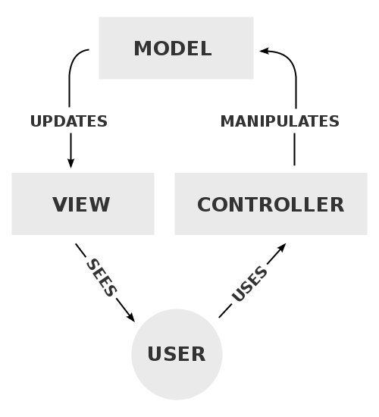

Slide 6
Benefits of MVC
Separation of concerns : for example if you want to change software logic you need not to touch user interface and vice versa.
It is a useful pattern that allows reuse of object code.
It significantly reduces the time it takes to develop the applications with the user interfaces
Decoupled code
Parallel development
Multiple view support

Slide 7
allows the re-use of the business logic across applications.
Each layer can work independently
Business logic developers can build the classes, while the UI developers can involve in designing UI screens simultaneously.
Due to the separation of the model from the view, the user interface can display multiple views of the same data at the same time.

Slide 8
GESTURES
People interact with an iOS device by performing gestures on the touchscreen. These gestures elicit a close personal connection with content and enhance the sense of direct manipulation of onscreen objects.

Slide 9
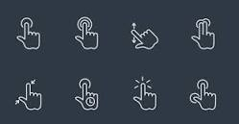
Gestures
The Multi-Touch screen displays a wealth of info, entertainment, and creativity, all at your fingertips. A few simple gestures, select, drag, swipe, and pinch, are all you need to explore and use iPhone apps. Press the Home button to return to the Home screen. Swipe left or right to see other screens.

Slide 10
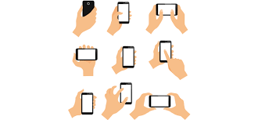
Mobile gestures are the movements made by a user to activate a specific control within a mobile interface. The majority of gestures are performed by the user's fingers (tap, swipe, drag, slide etc.) but can also involve hand movements (shaking, tilting, moving, and rotating the device).

Slide 11
Power on or off
To turn on, press and hold the side button until the Apple Logo appears.
To turn off, simultaneously press and hold the side button and either volume button until the slider appears, then slide to power off.

Slide 12
Wake and sleep
Raise to wake or tap to wake your iPhone X.
To put your iPhone X to sleep, press the side button.

Slide 13
Use intuitive gestures to get around
To create a continuous surface — with nothing to get in the way of your experience — the Home button has been replaced with new yet familiar ways to navigate. To begin, raise your iPhone and look toward it to unlock with Face ID. Or if it’s on a table or other flat surface, you can raise or tap to wake it.

Slide 14
Install apps
After selecting an app in the App Store, double-click the side button to install it.
Use Apple Pay
To authenticate purchases with Apple Pay using Face ID, double-click the side button, then glance at your iPhone X.

